Slide 1
Security
Dr. Muazzam A. Khan

Slide 2
Security
The Security Problem
Program Threats
System and Network Threats
Cryptography as a Security Tool
User Authentication
Implementing Security Defenses
Firewalling to Protect Systems and Networks
Computer-Security Classifications
An Example: Windows XP

Slide 3
The Security Problem
Security must consider external environment of the system, and protect the system resources
Intruders (crackers) attempt to breach security
Threat is potential security violation
Attack is attempt to breach security
Attack can be accidental or malicious
Easier to protect against accidental than malicious misuse

Slide 4
Building blocks of a secure system
Confidentiality: Concealment from unauthorized parties
  Identification – unique identifiers for all users
  Authentication
    user: assurance that the parties involved in a real-time transaction are who they say they are
  Authorization - allowing users who are identified and authenticated to use
Integrity: assurance the data is has not been modified by unauthorized parties
  non-repudiation (proof of integrity and origin of data which can be verified)
Availability: The system is available for users.

Slide 5
Viruses, Bots, and Phish,
What Is Information Security?
Deals with several different "trust" aspects of information and its protection
The U.S. Government’s National Information Assurance Glossary defines INFOSEC as:
    “Protection of information systems against unauthorized access to or modification of information, whether in storage, processing or transit, and against the denial of service to authorized users or the provision of service to unauthorized users, including those measures necessary to detect, document, and counter such threats.”

Slide 6
Malware:
  Hostile, intrusive, or annoying software or program code ("malicious" + "software“)
  Includes computer viruses, worms, trojan horses, bots, spyware, adware, etc
  Software is considered malware based on the intent of the creator rather than any particular features

Slide 7
Internet Bot
  Also known as web robots, are automated internet applications controlled by software agents
  These bots interact with network services intended for people, carrying out monotonous tasks.
  Bots can gather information, reply to queries, provide entertainment, and serve commercial purposes.
  Botnet - a network of "zombie" computers used to do automated tasks.

Slide 8
Adware
  Advertising-supported software
  A software package which automatically plays, displays, or downloads advertising material to a computer after the software is installed on it or while the application is being used.
  Adware is software integrated into or bundled with a program,
  Typically as a way to recover programming development costs through advertising income

Slide 9
Spyware
  A broad category of software designed to intercept or take partial control of a computer's operation without the informed consent of that machine's owner or legitimate user
  In simpler terms, spyware is a type of program that watches what users do with their computer and then sends that information over the internet

Slide 10
Spyware
  Spyware can collect many different types of information about a user:
    Records the types of websites a user visits
    Records what is typed by the user to intercept passwords or credit card numbers
    Used to launch “pop up” advertisements
  Many legitimate companies incorporate forms of spyware into their software for purposes of advertisement(Adware)

Slide 11
Spam
  Spamming is the abuse of electronic messaging systems to send unsolicited, undesired bulk messages
  Spam media includes:
    e-mail spam (most widely recognized form)
    instant messaging spam
    Usenet newsgroup spam
    Web search engine spam
    spam in blogs
    mobile phone messaging spam

Slide 12
Phishing
  A criminal activity using social engineering techniques.
  An attempt to acquire sensitive data, such as passwords and credit card details, by masquerading as a trustworthy person or business in an electronic communication.
  Typically carried out using email or an instant message

Slide 13
Security Violations
Categories
  Breach of confidentiality
  Breach of integrity
  Breach of availability
  Theft of service
  Denial of service
Methods
  Masquerading (breach authentication)
  Replay attack
    Message modification
  Man-in-the-middle attack
  Session hijacking
Notes:
https://searchsecurity.techtarget.com/definition/masquerade
https://www.geeksforgeeks.org/session-hijacking/

Slide 14
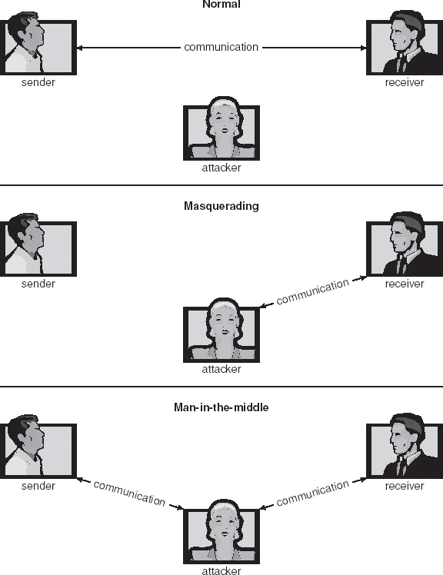
Standard Security Attacks

Slide 15
Security Measure Levels
Security must occur at four levels to be effective:
  Physical
  Human
  Operating System
  Network
Security is as weak as the weakest chain

Slide 16
Program Threats
Trojan Horse
  Code segment that misuses its environment
  Exploits mechanisms for allowing programs written by users to be executed by other users
  Spyware, pop-up browser windows,
Trap Door
  Specific user identifier or password that circumvents normal security procedures
  Could be included in a compiler
Logic Bomb
  Program that initiates a security incident under certain circumstances
Stack and Buffer Overflow
  Exploits a bug in a program (overflow either the stack or memory buffers)

Slide 17
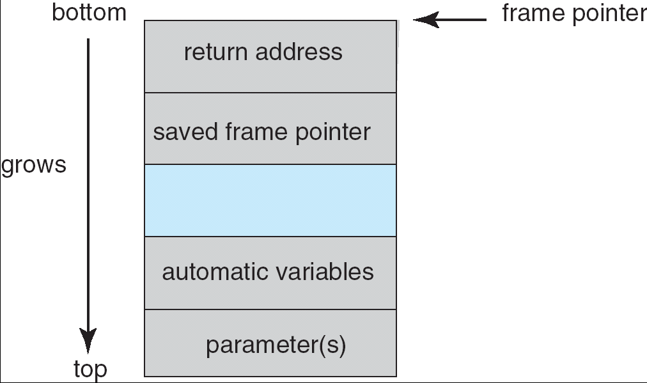
Layout of Typical Stack Frame

Slide 18
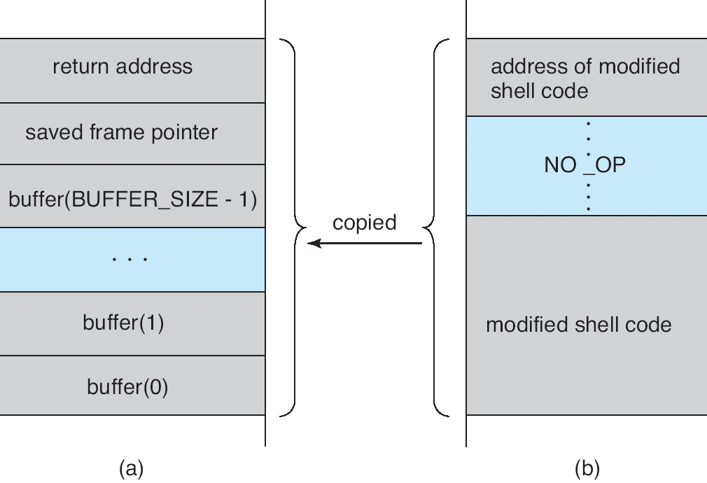
Hypothetical Stack Frame
Before attack
After attack

Slide 19
Program Threats (Cont.)
Viruses
  Code fragment embedded in legitimate program
  Very specific to CPU architecture, operating system, applications
  Usually borne via email or as a macro
    Visual Basic Macro to reformat hard drive

Slide 20
Program Threats (Cont.)
Virus dropper inserts virus onto the system
Many categories of viruses, literally many thousands of viruses
  File
  Boot
  Macro
  Source code
  Polymorphic
  Encrypted
  Stealth
  Tunneling
  Multipartite
  Armored

Slide 21
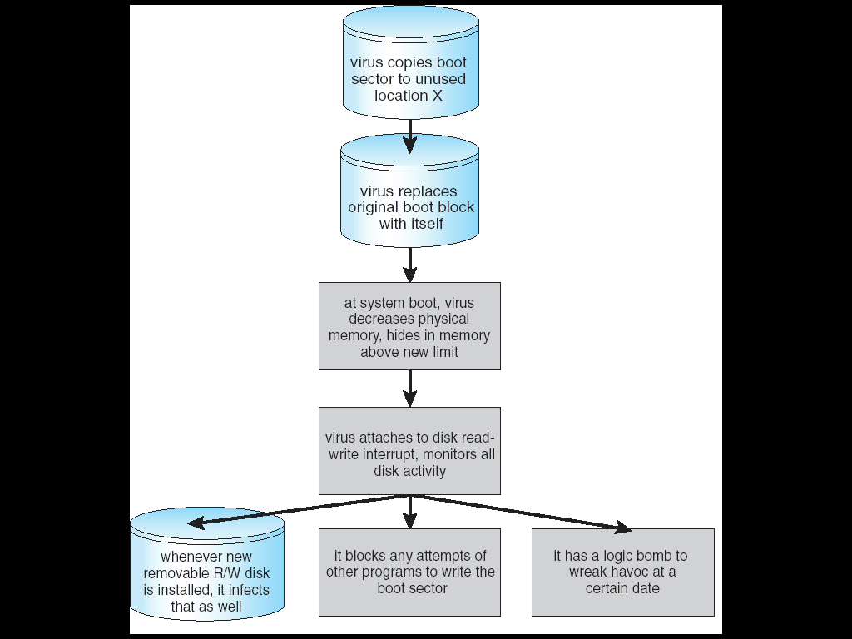
A Boot-sector Computer Virus

Slide 22
System and Network Threats
Worms –
  Worm is a standalone malware computer program that replicates itself in order to spread to other computers.
  Internet worm (Spread through internet)
  Grappling hook program uploaded main worm program
Port scanning
  Automated attempt to connect to a range of ports on one or a range of IP addresses. Mail servers listen on TCP port 25.
  A port scan attack, therefore, occurs when an attacker sends packets to your machine, varying the destination port.
Denial of Service
  Overload the targeted computer preventing it from doing any useful work.
  Distributed denial-of-service (DDOS) come from multiple sites at once.

Slide 23
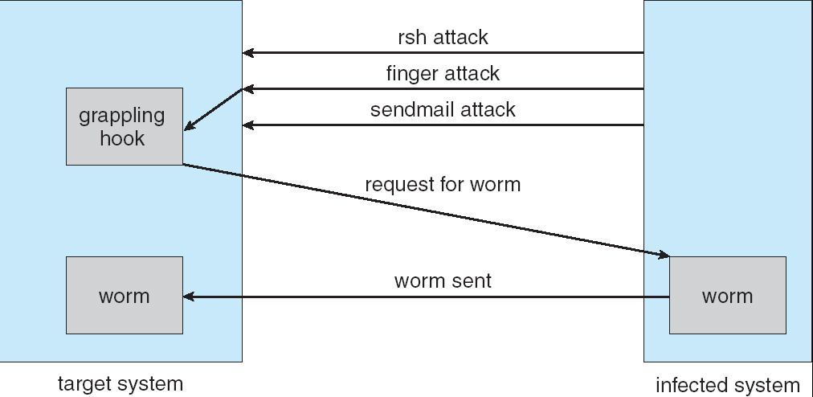
The Morris Internet Worm

Slide 24
Cryptography as a Security Tool
There are security tool available
  Source and destination of messages cannot be trusted without cryptography
  Means to constrain potential senders (sources) and / or receivers (destinations) of messages
Based on secrets (keys)

Slide 25
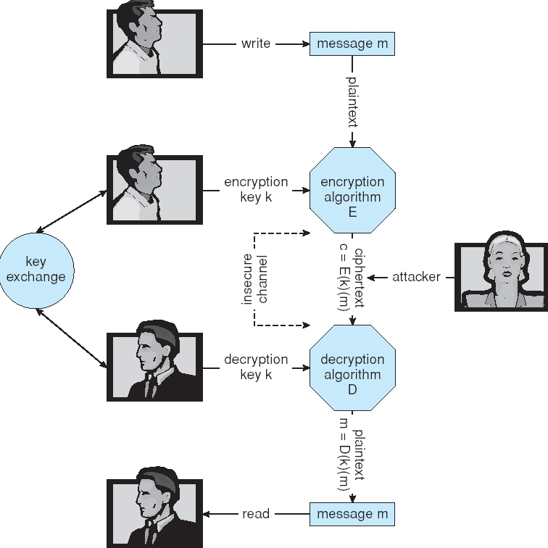
Secure Communication over Insecure Medium

Slide 26
Encryption
Encryption algorithm consists of
  Set of K keys
  Set of M Messages
  Set of C cipher texts (encrypted messages)
  A function E : K → (M→C). That is, for each k ∈ K, E(k) is a function for generating cipher texts from messages.
    Both E and E(k) for any k should be efficiently computable functions.
  A function D : K → (C → M). That is, for each k ∈ K, D(k) is a function for generating messages from cipher texts.
    Both D and D(k) for any k should be efficiently computable functions.
  Computer holding D(k) can decrypt cipher texts to the plaintexts used to produce them, but a computer not holding D(k) cannot decrypt cipher texts.

Slide 27
Symmetric Encryption
Same key used to encrypt and decrypt
  E(k) can be derived from D(k), and vice versa
DES is most commonly used symmetric block-encryption algorithm (created by US Govt)
  Encrypts a block of data at a time
Triple-DES considered more secure
Advanced Encryption Standard (AES)
RC4 is most common symmetric stream cipher, but known to have vulnerabilities
  Encrypts/decrypts a stream of bytes (i.e wireless transmission)
  Key is a input to psuedo-random-bit generator
    Generates an infinite key stream
Notes:
https://www.ssl2buy.com/wiki/symmetric-vs-asymmetric-encryption-what-are-differences

Slide 28
Asymmetric Encryption
Public-key encryption based on each user having two keys:
  Public key – published key used to encrypt data
  Private key – key known only to individual user used to decrypt data
Must be an encryption scheme that can be made public without making it easy to figure out the decryption scheme
  Most common is RSA block cipher
  No efficient algorithm is known for finding the prime factors of a number

Slide 29
Asymmetric Encryption (Cont.)
Formally, it is computationally infeasible to derive D(k_{d} , N) from E(k_{e} , N), and so E(k_{e} , N) need not to be kept secret.
  E(k_{e} , N) (or just k_{e}) is the public key
  D(k_{d} , N) (or just k_{d}) is the private key
  N is the product of two large, randomly chosen prime numbers p and q (for example, p and q are 512 bits each)
  Encryption algorithm is E(k_{e} , N)(m) = m^{ke} mod N, where k_{e} satisfies k_{e}k_{d} mod (p−1)(q −1) = 1
  The decryption algorithm is then D(k_{d} , N)(c) = c^{kd} mod N

Slide 30
Asymmetric Encryption Example
For example. make p = 7and q = 13
We then calculate N = 7∗13 = 91 and (p−1)(q−1) = 72
We next select k_{e} relatively prime to 72 and< 72, yielding 5
Finally,we calculate k_{d} such that k_{e}k_{d} mod 72 = 1, yielding 29
We how have our keys
  Public key, k_{e,} N = 5, 91
  Private key, k_{d} , N = 29, 91
Encrypting the message 69 with the public key results in the cipher text 62
Cipher text can be decoded with the private key
  Public key can be distributed in clear text to anyone who wants to communicate with holder of public key

Slide 31
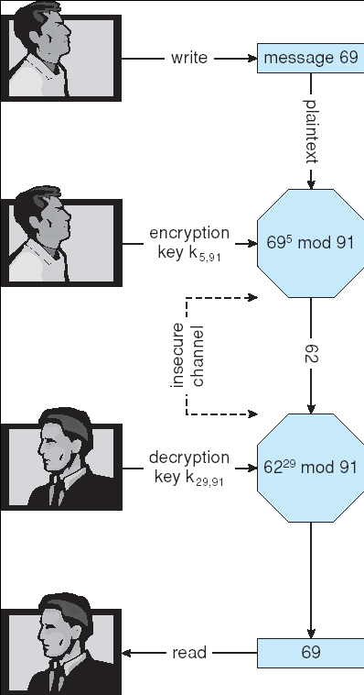
Encryption and Decryption using RSA Asymmetric Cryptography

Slide 32
Cryptography (Cont.)
Note symmetric cryptography based on transformations, asymmetric based on mathematical functions
  Asymmetric is computationally more intensive
  Typically not used for bulk data encryption

Slide 33
Authentication
Authentication is the process of validating the identity of someone or something.
Generally authentication requires the presentation of credentials or items of value to really prove the claim of who you are.
The items of value or credential are based on several unique factors that show something you know, something you have, or something you are

Slide 34
Authentication
Constraining set of potential senders of a message
  Complementary and sometimes redundant to encryption
  Also can prove message unmodified
Algorithm components
  A set K of keys
  A set M of messages
  A set A of authenticators
  A function S : K → (M→ A)
    That is, for each k ∈ K, S(k) is a function for generating authenticators from messages
    Both S and S(k) for any k should be efficiently computable functions
  A function V : K → (M× A→ {true, false}). That is, for each k ∈ K, V(k) is a function for verifying authenticators on messages
    Both V and V(k) for any k should be efficiently computable functions

Slide 35
Authentication (Cont.)
For a message m, a computer can generate an authenticator a ∈ A such that V(k)(m, a) = true only if it possesses S(k)
Thus, computer holding S(k) can generate authenticators on messages so that any other computer possessing V(k) can verify them
Computer not holding S(k) cannot generate authenticators on messages that can be verified using V(k)
Since authenticators are generally exposed (for example, they are sent on the network with the messages themselves), it must not be feasible to derive S(k) from the authenticators

Slide 36
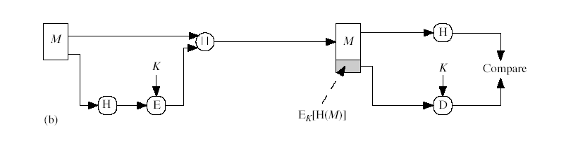
Authentication – Hash Functions
It condenses arbitrary message to fixed size
Hash is used to detect changes to message
can use in various ways with message
most often to create a digital signature
A Hash Function produces a fingerprint of some file/message/data
  h = H(M)
Notes:
https://www.cryptomathic.com/news-events/blog/differences-between-hash-functions-symmetric-asymmetric-algorithms

Slide 37
Authentication – Hash Functions
Basis of authentication
Creates small, fixed-size block of data (message digest, hash value) from m
If H(m) = H(m’), then m = m’
  The message has not been modified
Common message-digest functions include MD5, which produces a 128-bit hash, and SHA-1, which outputs a 160-bit hash

Slide 38
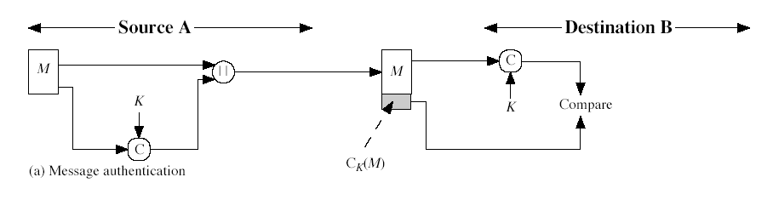
Authentication - MAC
MAC is generated by an algorithm that creates a small fixed-sized block
  depending on both message and some key
Appended to message as a signature
Receiver performs same computation on message and checks it matches the MAC
It provides assurance that message is unaltered and comes from sender

Slide 39
Authentication - MAC
Symmetric encryption used in message-authentication code (MAC) authentication algorithm
Simple example:
  MAC defines S(k)(m) = f (k, H(m))
    Where f is a function that is one-way on its first argument
      k cannot be derived from f (k, H(m))
    Because of the collision resistance in the hash function, reasonably assured no other message could create the same MAC
    Note that k is needed to compute both S(k) and V(k), so anyone able to compute one can compute the other

Slide 40
Digital Certificates
We have looked at message authentication
  but does not address issues of lack of trust
Digital signatures provide the ability to:
  verify author, date & time of signature
  authenticate message contents
  be verified by third parties to resolve disputes
Trusted party receives proof of identification from entity and certifies that public key belongs to entity
Certificate authority are trusted party – their public keys included with web browser distributions

Slide 41
Authentication – Digital Signature
Based on asymmetric keys and digital signature algorithm
Authenticators produced are digital signatures
In a digital-signature algorithm, computationally infeasible to derive S(k_{s} ) from V(k_{v})
  V is a one-way function
  Thus, k_{v} is the public key and k_{s} is the private key
Consider the RSA digital-signature algorithm
  Similar to the RSA encryption algorithm, but the key use is reversed
  Digital signature of message S(k_{s} )(m) = H(m)^{ks} mod N
  The key k_{s} again is a pair d, N, where N is the product of two large, randomly chosen prime numbers p and q
  Verification algorithm is V(k_{v})(m, a) ≡ (a^{kv} mod N = H(m))
    Where k_{v} satisfies k_{v}k_{s} mod (p − 1)(q − 1) = 1

Slide 42
Authentication (Cont.)
Why authentication if a subset of encryption?
  Fewer computations (except for RSA digital signatures)
  Authenticator usually shorter than message
  Sometimes want authentication but not confidentiality
  Can be basis for non-repudiation

Slide 43
Key Distribution
Most important component in secure transmission.
Delivery of symmetric key is huge challenge
  Sometimes done out-of-band
Options: (between A and B).
  A selects a key and physically delivers it to B.
  A trusted third party key distribution center (KDC) selects a key and physically delivers it to A and B.
  If A and B already have a viable key, it can be used to distribute a new key.
  If A and B have a secure link to KDC, can receive the key through that channel.

Slide 44
Public Key Management
Asymmetric keys can proliferate – stored on key ring
  Even asymmetric key distribution needs care – man-in-the-middle attack
Distribution of public keys
  Public announcement
  Public directories
  Public-key authority
  Public-key certificates
Use of public-key encryption to distribute secret keys

Slide 45
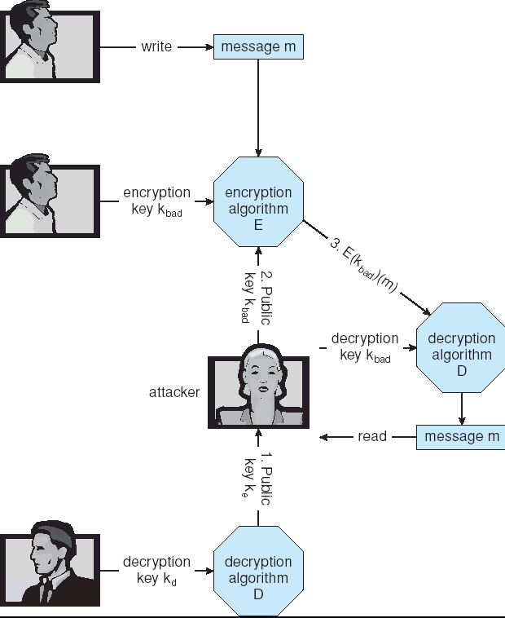
Man-in-the-middle Attack on Asymmetric Cryptography

Slide 46
SSL (Secure Socket Layer)
Transport layer security service
originally developed by Netscape
version 3 designed with public input
subsequently became Internet standard known as TLS (Transport Layer Security)
uses TCP to provide a reliable end-to-end service
SSL has two layers of protocols
Notes:
SSL probably most widely used Web security mechanism. Its implemented at the Transport layer; cf IPSec at Network layer; or various Application layer mechanisms eg. S/MIME & SET (later).

Slide 47
Where SSL Fits
HTTP SMTP POP3
80 25 110
HTTPS SSMTP POP3
443 465 995
Secure Sockets Layer
Transport
Network
Link

Slide 48
Uses Public Key Scheme
Each client-server pair uses
  2 public keys
    one for client (browser)
      created when browser is installed on client machine
    one for server (http server)
      created when server is installed on server hardware
  2 private keys
    one for client browser
    one for server (http server)

Slide 49
Encryption Example - SSL
Used between web servers and browsers for secure communication (credit card numbers)
The server is verified with a certificate assuring client is talking to correct server
Asymmetric cryptography used to establish a secure session key (symmetric encryption) for bulk of communication during session

Slide 50
User Authentication
Crucial to identify user correctly, as protection systems depend on user ID
User identity most often established through passwords, can be considered a special case of either keys or capabilities
  Also can include something user has and /or a user attribute
Passwords must be kept secret
  Frequent change of passwords
  Use of “non-guessable” passwords
  Log all invalid access attempts
Passwords may also either be encrypted or allowed to be used only once

Slide 51
Implementing Security Defenses
Defense in depth is most common security theory – multiple layers of security
Security policy describes what is being secured
Vulnerability assessment compares real state of system/ network.
Intrusion detection endeavors to detect attempted or successful intrusions
  Signature-based detection spots known bad patterns
  Anomaly detection spots differences from normal behavior
    Can detect zero-day attacks (A zero day vulnerability refers to a hole in software that is unknown to the vendor. This security hole is then exploited by hackers before the vendor becomes aware.)
  False-positives and false-negatives a problem
Virus protection
Auditing, accounting, and logging of all activities

Slide 52
Firewalling to Protect Systems and Networks
A network firewall is placed between trusted and untrusted hosts
Can be tunneled or spoofed
  Tunneling allows disallowed protocol to travel within allowed protocol (i.e. telnet inside of HTTP)
Personal firewall is software layer on given host
System-call firewall monitors all important system calls and apply rules to them (i.e. this program can execute that system call)

Slide 53
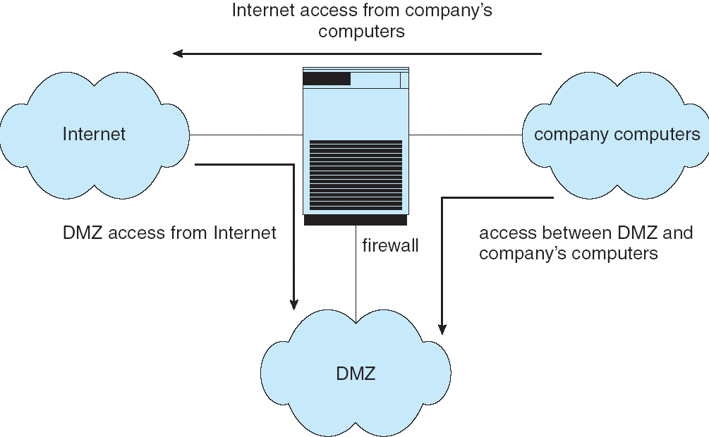
Network Security Through Domain Separation Via Firewall

Slide 54
Computer Security Classifications
U.S. Department of Defense outlines four divisions of computer security: A, B, C, and D.
D – Minimal security.
C – Provides discretionary protection through auditing. Divided into C1 and C2. C1 identifies cooperating users with the same level of protection. C2 allows user-level access control.
B – All the properties of C, however each object may have unique sensitivity labels. Divided into B1, B2, and B3.
A – Uses formal design and verification techniques to ensure security.

Slide 55
Example: Windows XP/Win Server
Security is based on user accounts
  Each user has unique security ID
  Login to ID creates security access token
    Includes security ID for user, for user’s groups, and special privileges
    Every process gets copy of token
    System checks token to determine if access allowed or denied
Uses a subject model to ensure access security. A subject tracks and manages permissions for each program that a user runs
Each object in Windows XP has a security attribute defined by a security descriptor
  For example, a file has a security descriptor that indicates the access permissions for all users

Slide 56
The End

